Slide 1
The Modernized National Career Clusters ® Framework
Dr. Melissa DeLaurentis, CCRB
Statewide CTE Advisory Board
February 12, 2025
Investing for tomorrow, delivering today.

Slide 2
Purpose Statement
The National Career Clusters Framework provides structural alignment and a common language to bridge education and work, empowering each learner to explore, decide on, and prepare for dynamic and evolving careers.
Notes:
This purpose statement was created by the Advance CTE Board of Directors at the start of the Advancing the Framework Initiative
There are a few key points to keep in mind about validation and implementation, which will be explained on the next slide.

Slide 3
The Original National Career Clusters® Framework
Launched in 2002, the original National Career Clusters Framework was designed to:
collect educational groupings using common knowledge and skill statements.
guide learners through an aligned program of study that leads to a career-oriented future .
16
Career Clusters
Developed as a new means to organize CTE programs
79
Career Pathways
To help learners navigate their way to greater success in college and career
Notes:
The original framework, that we are currently utilizing, consists of 16 career clusters and 79 career pathways. This is the base of our current CTE Programs of Study and how we report Perkins data to the federal government.

Slide 4
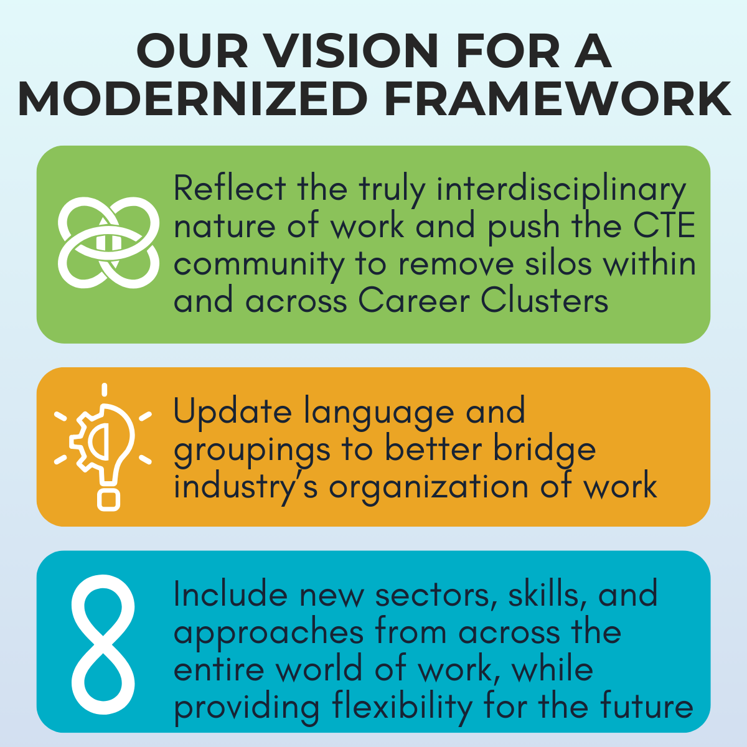
Why Modernize the Career Clusters® Framework?
The Need for A Modernized Framework Since the Framework’s creation in 2002, there have been tremendous shifts in the labor market, the nature of work and the workplace, and the role of technology. The original Framework does not reflect these changes.
Notes:
The Framework is being modernized to make it more responsive to the needs of industry and learners seeking good-paying jobs and sustainable career pathways.
A modernized Framework will:
reflect the truly interdisciplinary nature of work through more interconnections across clusters;
update language and groupings to better bridge industry’s organization of work with education;
include new sectors, skills, and approaches from the entire world of work, while providing flexibility for the future.
allow each state to implement the Framework to meet the needs of learners and labor markets they serve.

Slide 5
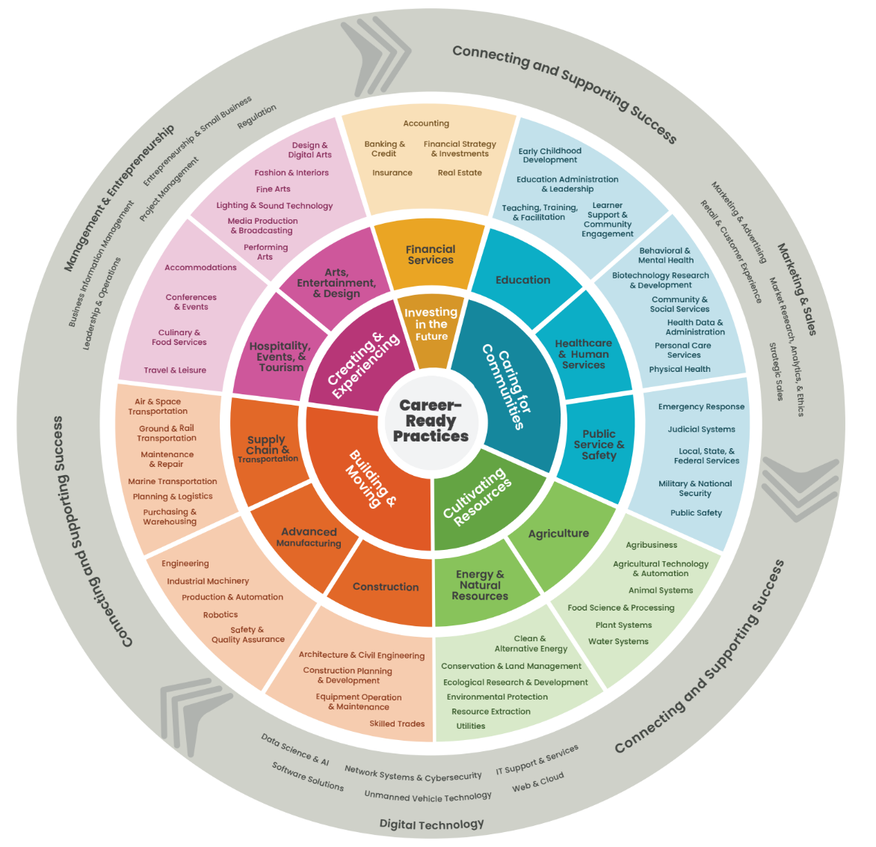
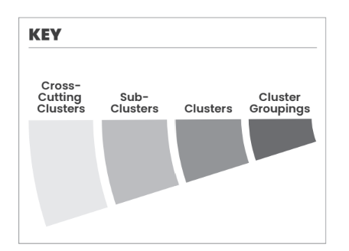
The Modernized
National Career Clusters® Framework
Notes:
Go over each of the section s of the Modernized National Career Cluster Framework.

Slide 6
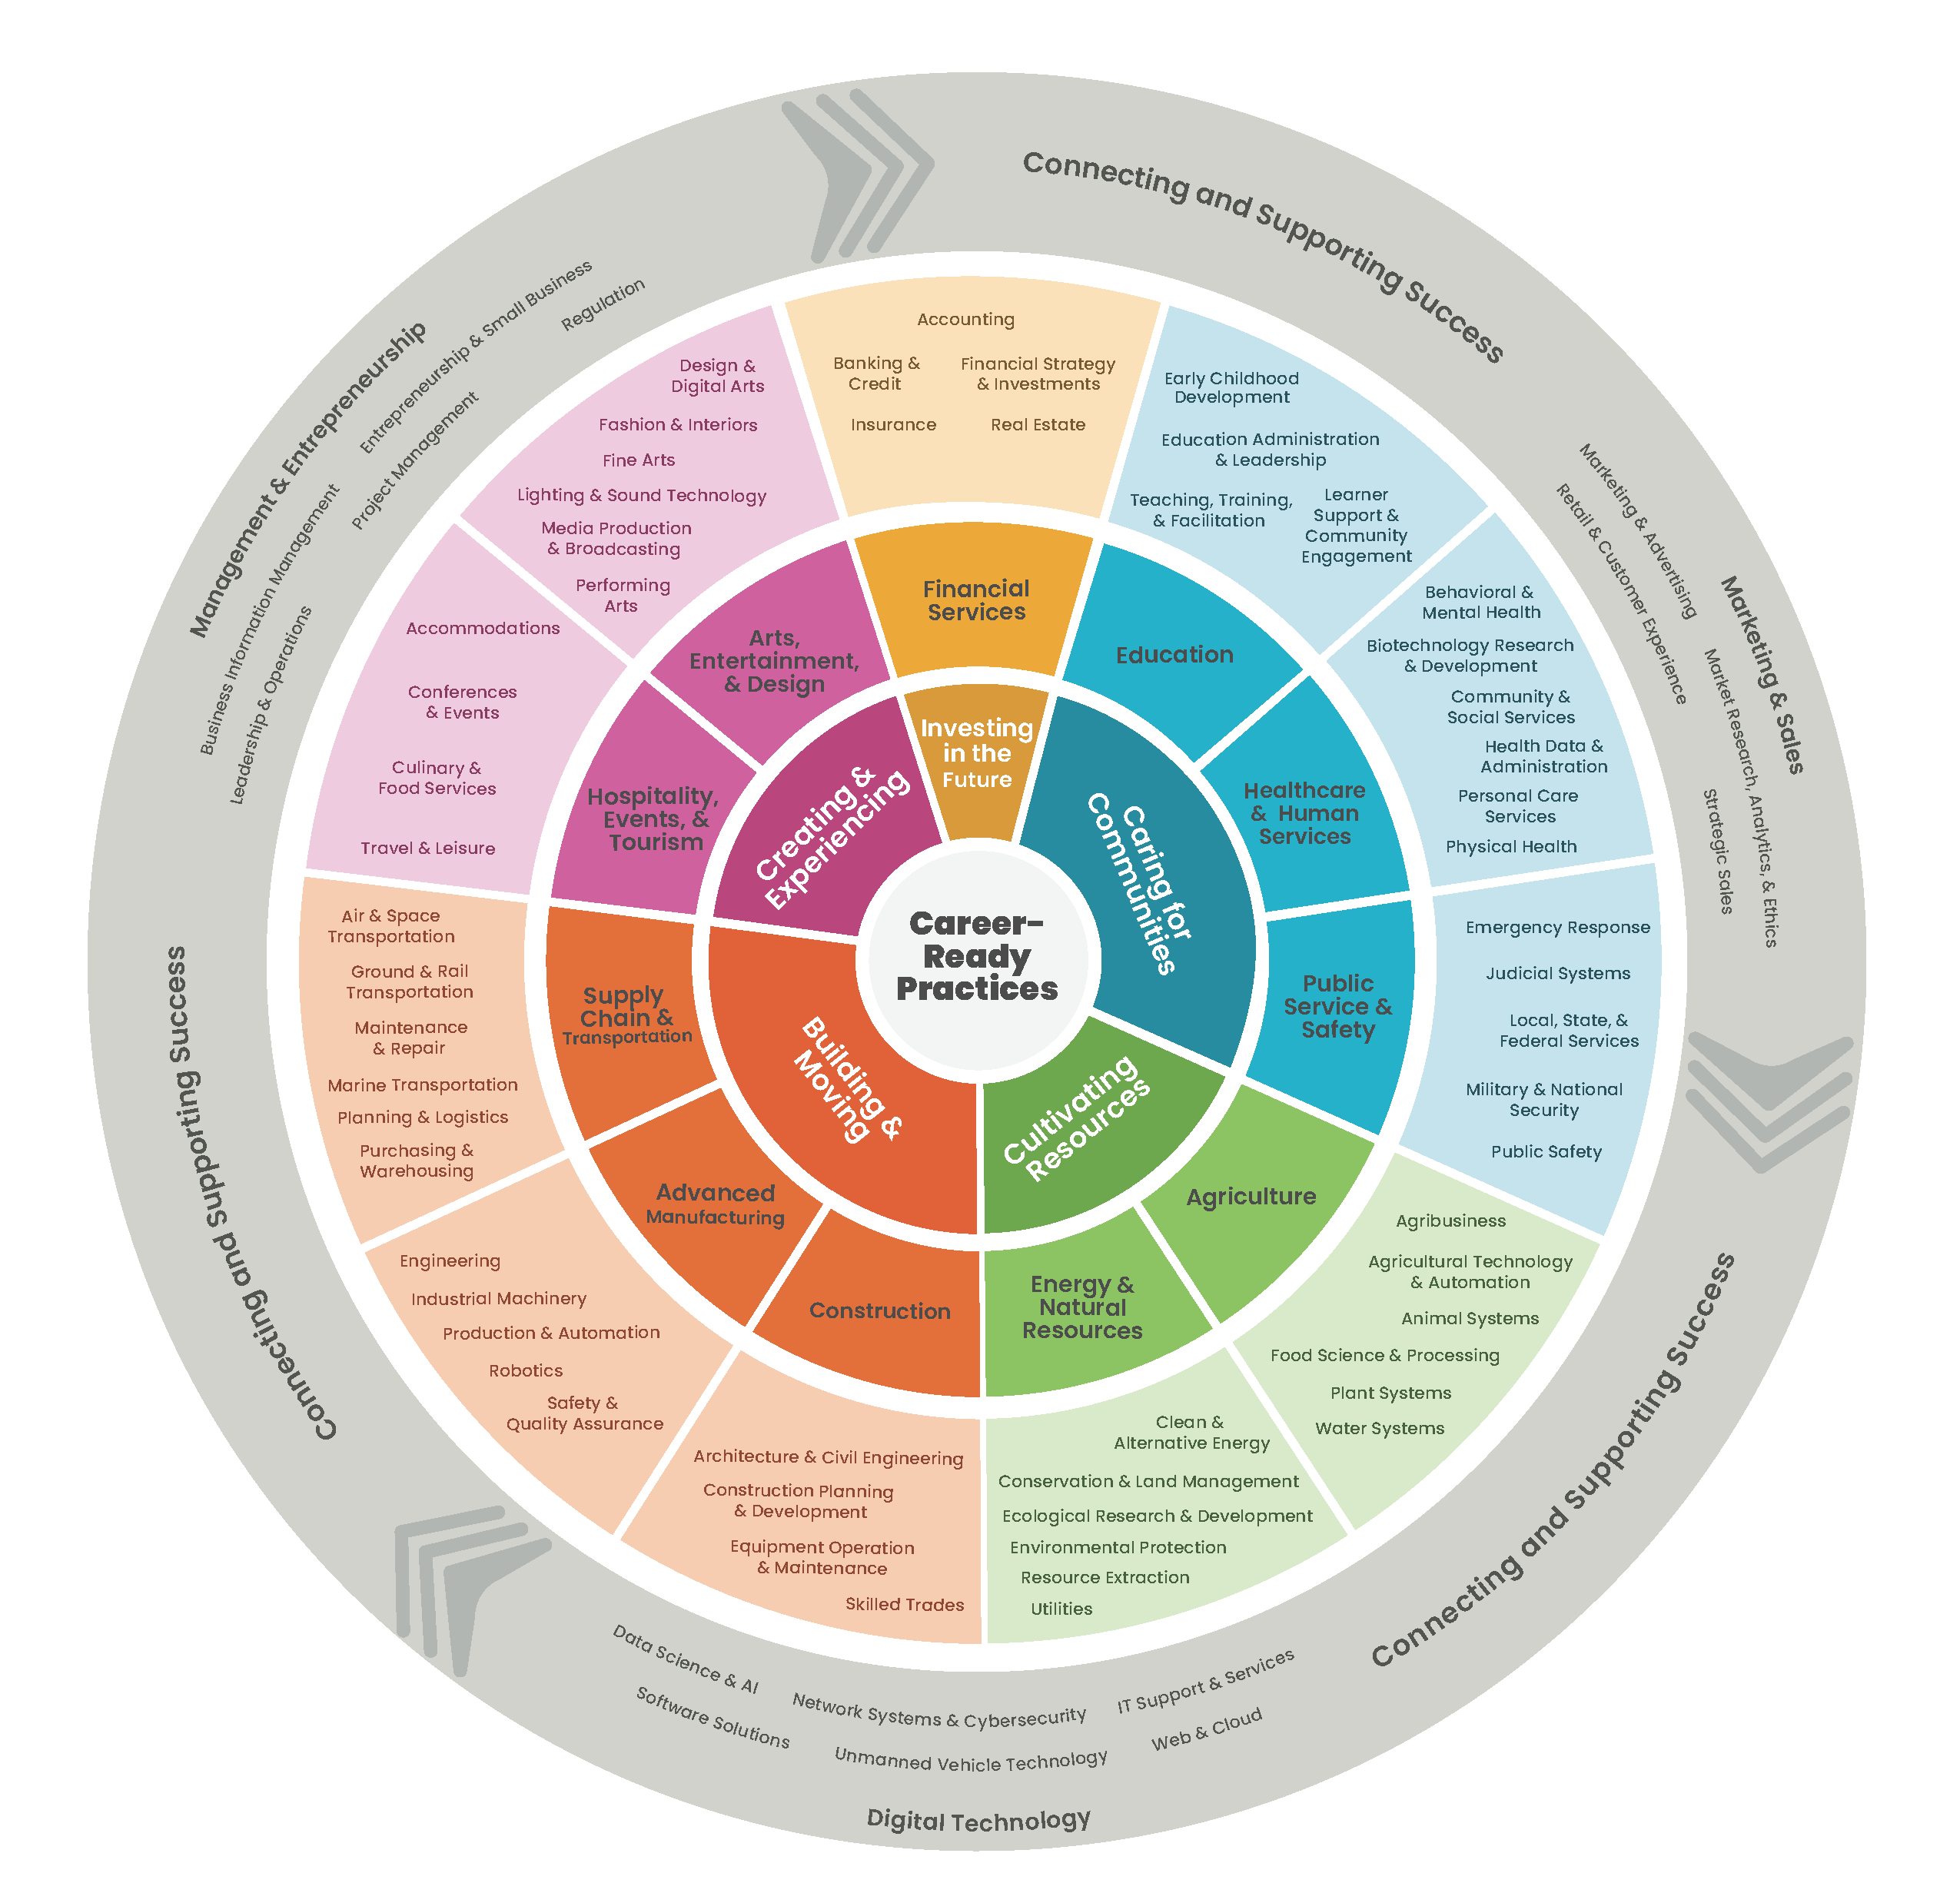
The Modernized National Career Clusters® Framework
The Modernized National Career Clusters® Framework:
provides an updated foundation for how we organize and deliver CTE programs that is industry responsive.
represents the full range of skilled, living wage jobs.
helps prepare learners for the jobs of the future.
Notes:
Read the bullets.

Slide 7
Summary of Major Changes
Nothing was removed, only reorganized - everything is located somewhere.
Modernization of world of work
Introduction of major modern industry focuses, including advanced technologies, automation, robotics, etc.
IT was expanded to Digital Technology
Expansion of Energy, Advanced Manufacturing into Framework

Slide 8
Summary of Major Changes (continued)
More reflective of industry sectors
Law and Public Safety, Government and Public Administration combined
Natural Resources moved from Agriculture to Energy
Combined Health Sciences & Human Services into Healthcare & Human Services
Dissolution of STEM cluster
Development of cross-cutting clusters
State-level customizability

Slide 9
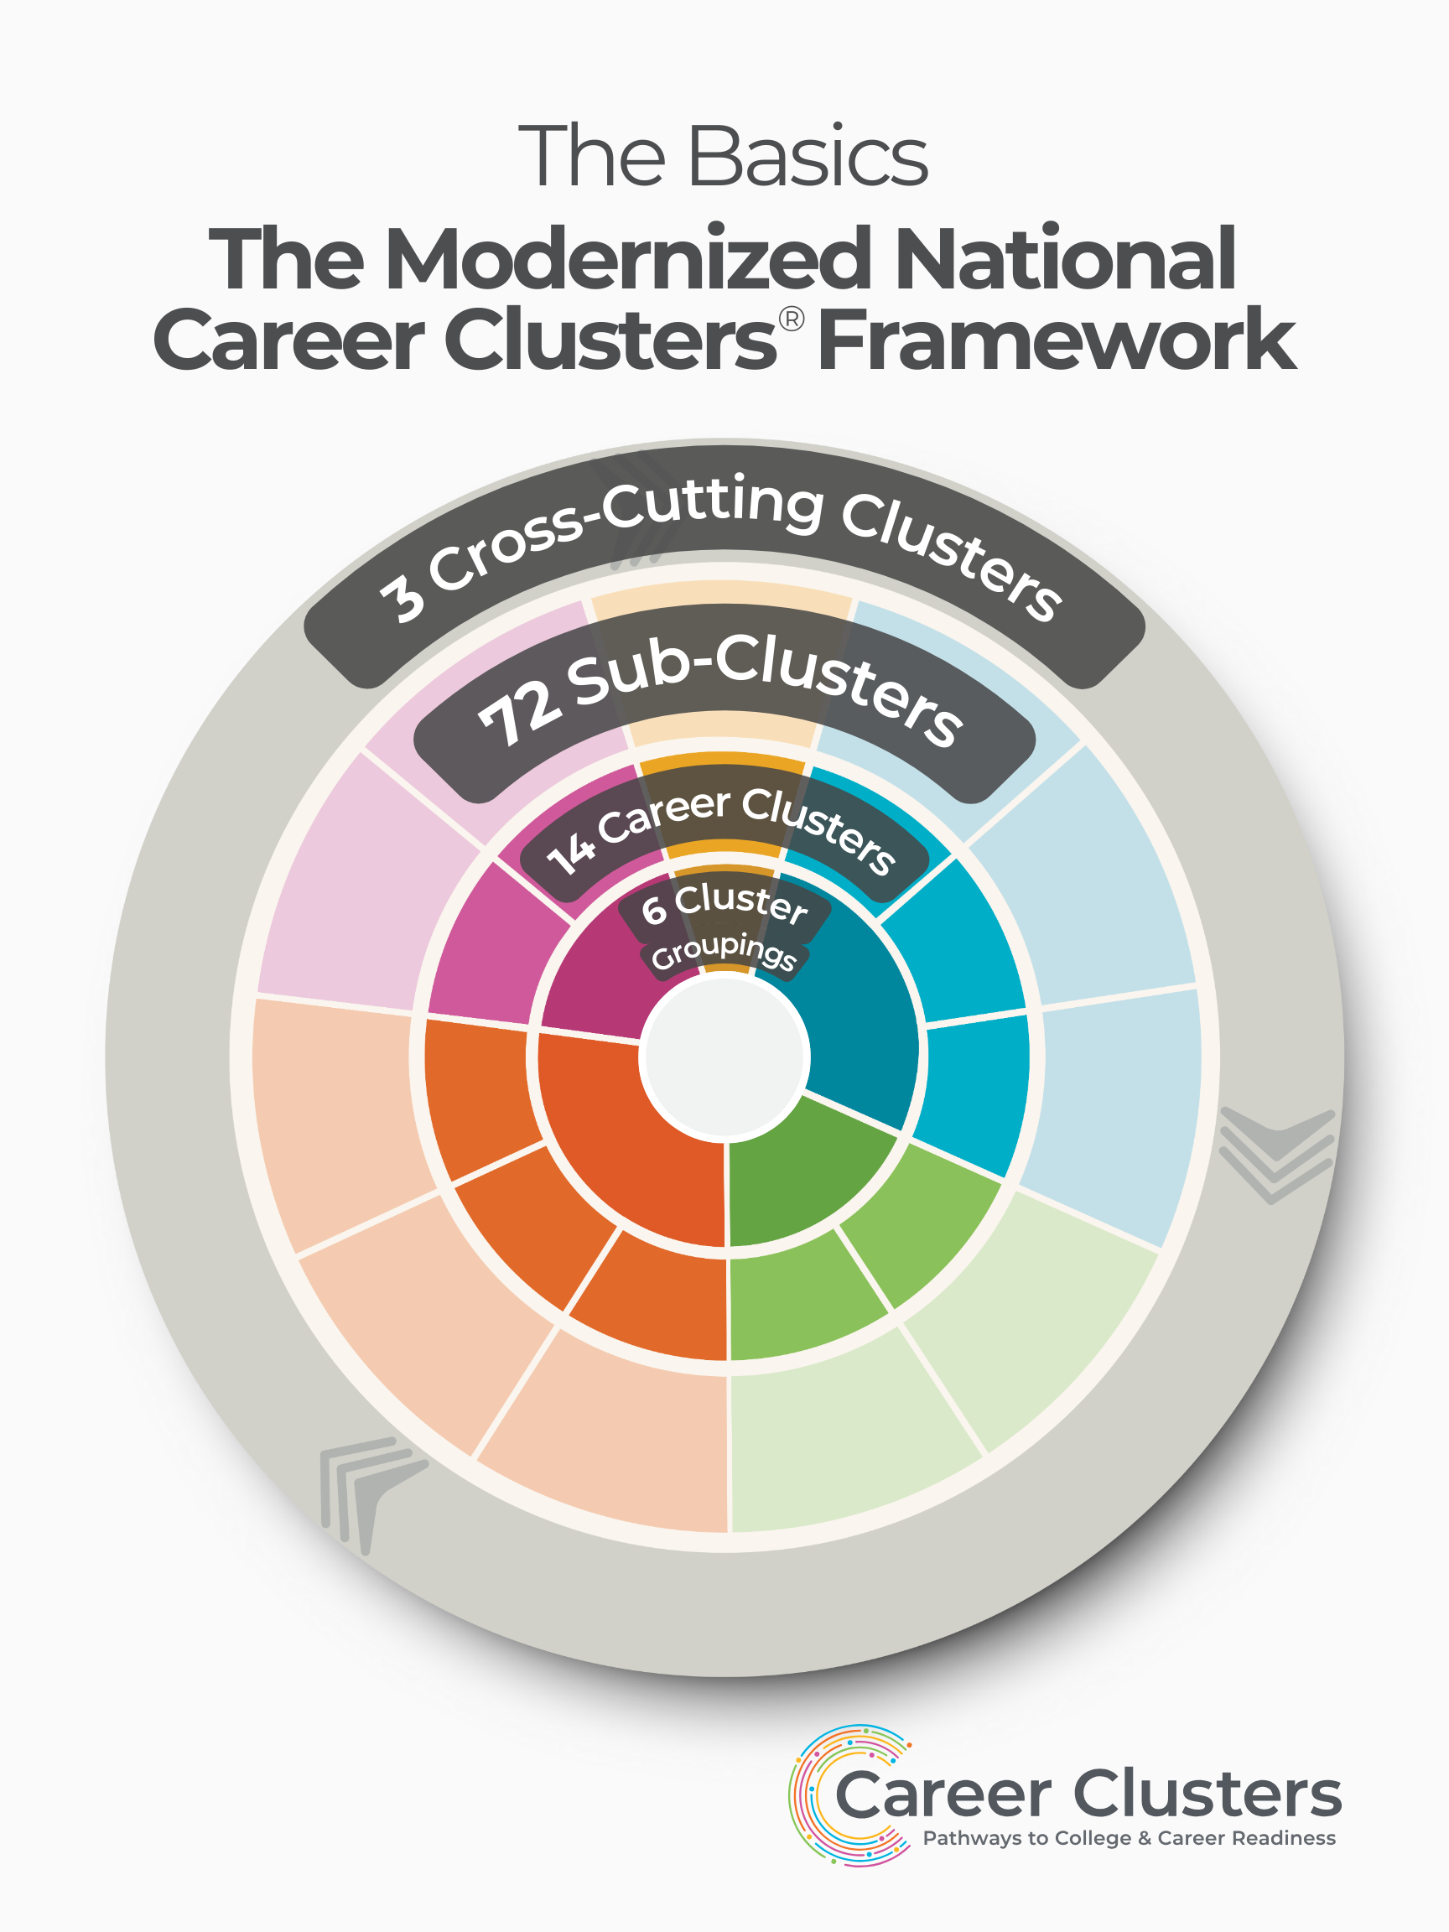
Career Clusters
(including Cross-Cutting Clusters)
14
Sub-Clusters (NEW)
Career
Ready
Practices
72
Notes:
The gives the numbers side of what the Framework is made up of.

Slide 10
Layer: Cluster Groupings
Large purpose-driven meta-sectors that help guide young people toward Clusters that are aligned with their interests, their sense of purpose, and the impact they want to make on their communities
Aid learners to see career opportunities across multiple Career Clusters
Career
Ready
Practices

Slide 11
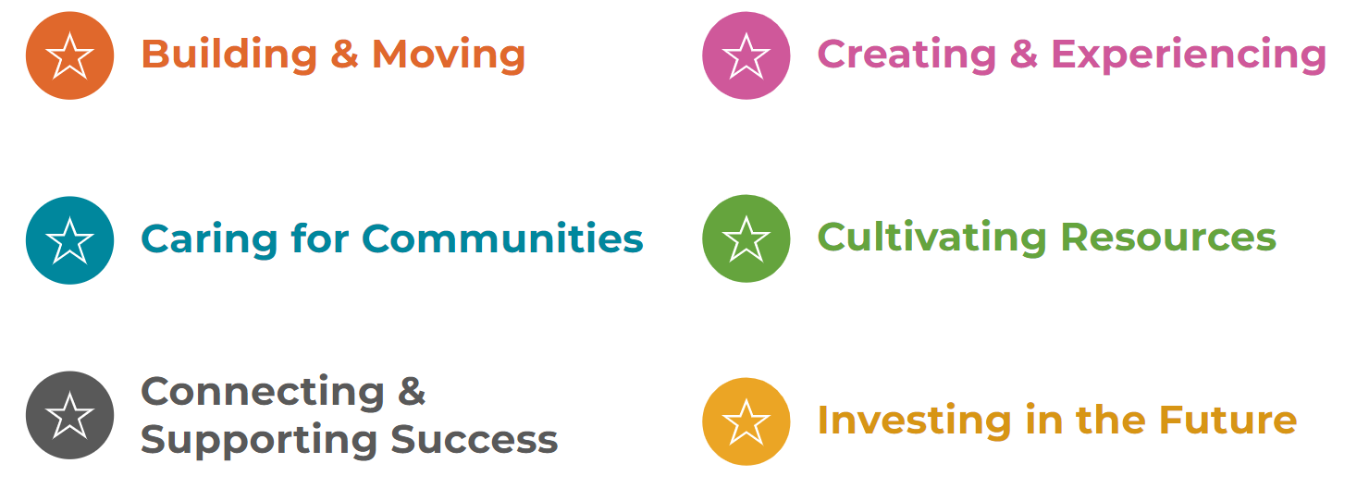
Cluster Groupings

Slide 12
Layer: Career Clusters
Industry sectors as defined by groupings from Standard Occupational Classification (SOC) and North American Industry Classification System (NAICS) codes
States have historically used this as foundation for CTE program of study design.
Career
Ready
Practices

Slide 13
Modernized Career Clusters
14
Career Clusters

Slide 14
Layer: Sub-Clusters
Major groupings of career areas within a given field that have similar skills as defined by industry area
Each Cluster contains multiple Sub-Clusters.
Can be customized to align with state and community labor market data and program structure
Career
Ready
Practices

Slide 15
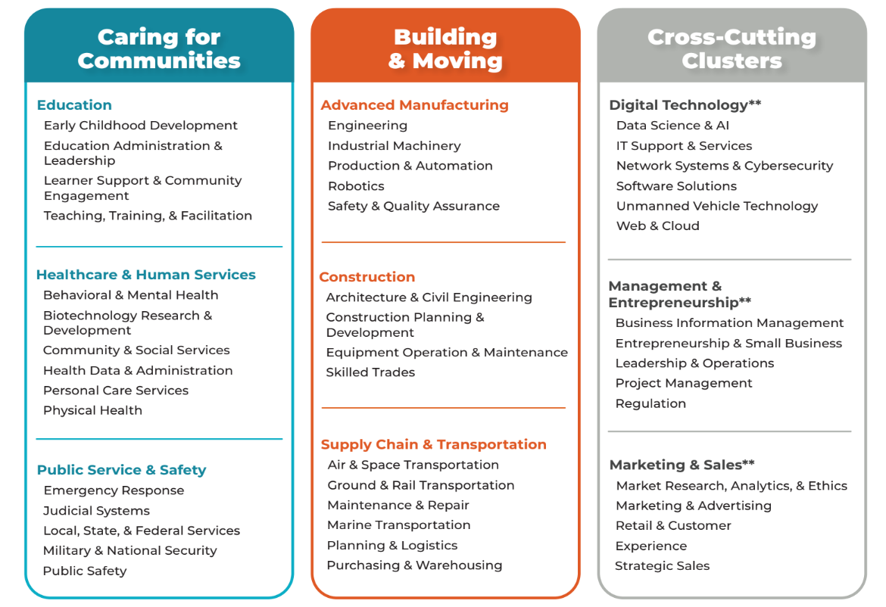
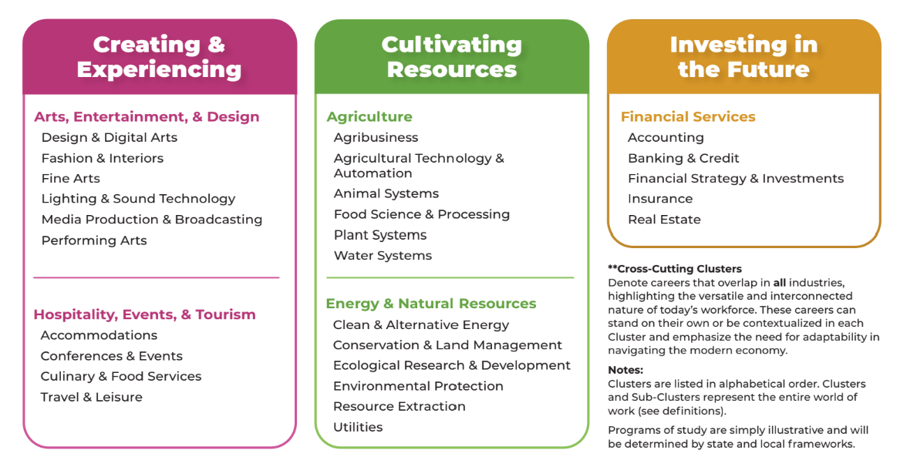
Career Clusters Framework: Grid View

Slide 16
Layer: Cross-Cutting Clusters
Clusters that are based on both sector-specific and contextualized functions instead of purely discrete industry sectors. These Clusters have both Sub-Clusters and implications for courses taken in all other Career Clusters.
Cross-Cutting Clusters are both a standalone Cluster but can also be combined with other Career Clusters.
Digital Technology, Marketing & Sales, Management & Entrepreneurship

Slide 17
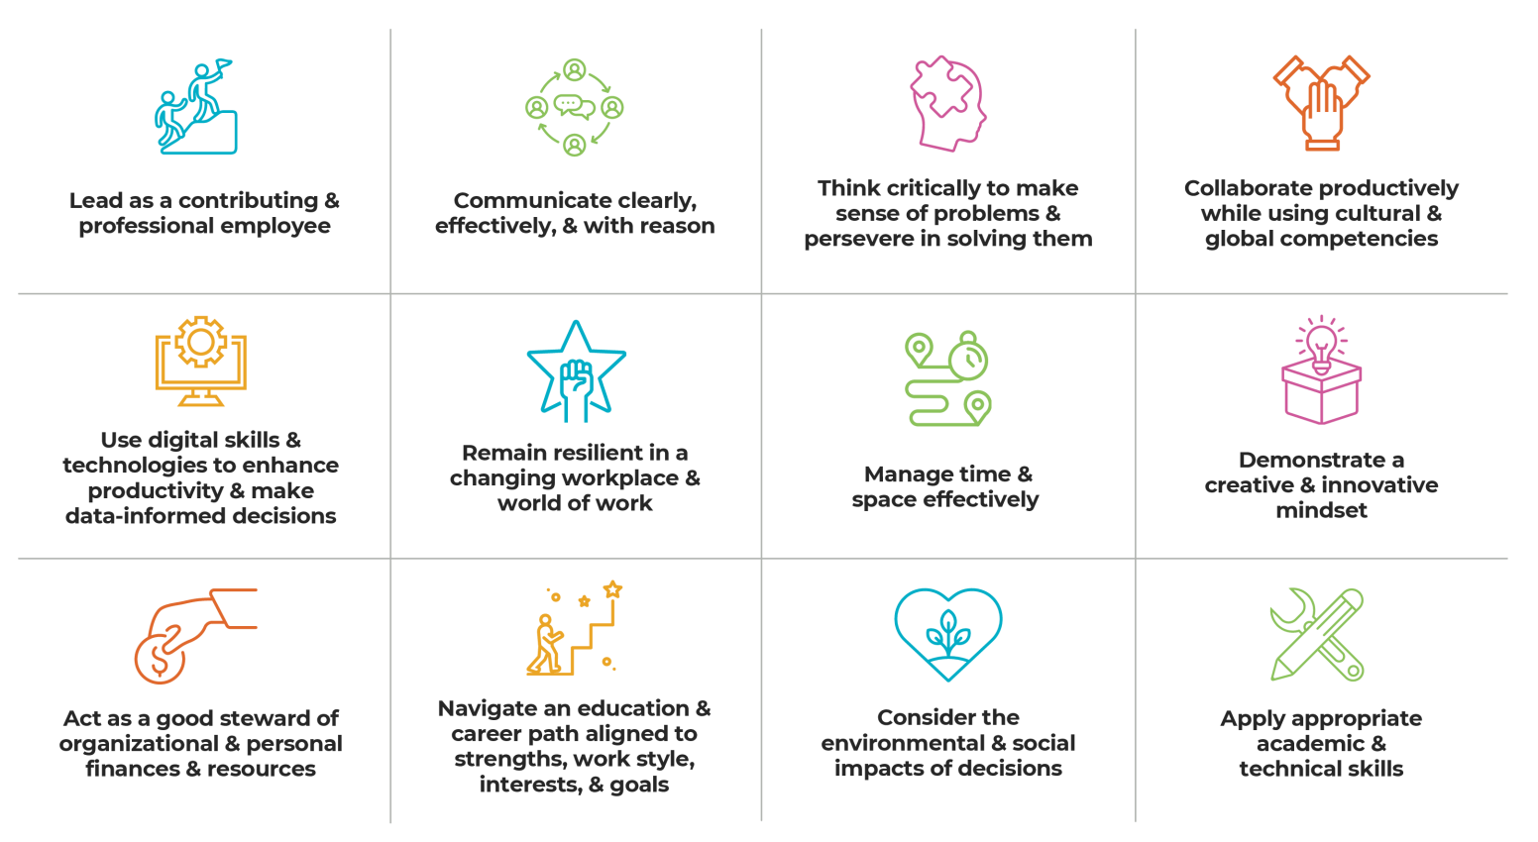
Layer: Career Ready Practices (CRP)
Built on a meta-analysis of over 30 different listings of general professional skills developed by industry and educational institutions, represent the skills needed to succeed in the modern workplace
These 12 practices should be embedded across the pre-kindergarten to workforce continuum and within each Career Cluster.

Slide 18
Users of the Framework
Notes:
Information for each category: https://careertech.org/career-clusters/your-place-in-the-framework/. Benefits are also listed for some on the next slide.

Slide 19
The Benefits of a Modernized National Career Clusters® Framework
Learners
Have access to more personalized paths to living wage jobs
CTE Educators
Can align, design, and deliver programs that better reflect the interdisciplinary nature of work and the clusters
Industries
Can hire learners with a lifelong learning worldview whose interests, skills, and work-based experiences align with industry sector and hiring needs.
State CTE Leaders
Can design programs and experiences that are more responsive to industry needs
Gain skills for a variety of careers
More connected career readiness language that acts as a bridge between industry and education
Provide resources and guidance to local leaders that reflect the needs of the modern workplace
Enhances connection between in- and out of-classroom experiences, such as work-based learning
Allows for stronger career exploration and advising models
Utilize language to describe their future careers more aligned with what is used by industry.
….and so many more!
Notes:
This modernization strives to benefit all users of the current Framework.

Slide 20
The Modernization Methodology
Decisions about the structure of a modernized Framework was developed based on:
Analyses of the North American Industry Classification System (NAICS) and Standard Occupation Codes (SOC)
Input from 13 sector specific Industry Advisory Groups
Sector-specific labor
market research validated by industry professionals
in each sector.
Direct input from the CTE community through member workshops and educator and partner organization input groups
State-level analysis of how the current Framework is being implemented and adapted
2 National surveys of original Framework’s use, strengths and weaknesses and validation of draft modernized Framework
Notes:
The methodology behind the modernization process was intended to make the Framework more industry based, learner-centered, and more responsive to what will be continual transformations to the world of work.
This was both accomplished through analysis of industry classifications and with substantial input from industry advisory groups.
It is important to note that while the Framework is based on national data, it is—as it always has been—designed to be flexible so that states can adopt and adapt it based on their specific labor market needs.

Slide 21
State Implementation Support
Advance CTE will multiple avenues to support state members and their teams during the implementation phase, providing tools and resources, including:
Early Adopter Cohort
Mapping and execution of systems change by group of early states
Resource Support
Provide briefs, audit tool, communication materials, and additional crosswalks in response to state and local needs
Convening Spaces
Topic and role-based communities for state teams to learn from each other throughout implementation
Technical Assistance
One-time and intensive technical assistance to meet specific state needs
Knowledge sharing of early innovations and lessons learned
Notes:
This support will empower state CTE teams to support other agencies and district during the implementation process.

Slide 22
New Mexico's Alignment to the Revised Career Cluster Framework
New Mexico is an early implementer state for the revised career cluster framework:
Reorganization of current state-level clusters
Realignment of the CTE programs of study to the revised framework
Diverse community feedback on POS alignment and course progression.
Updates to data system design, collection, and analysis
All existing New Mexico CTE Programs of Study will still be available for FY26. However, the POS may be within a revised career cluster.
Your CCRB CTE Coach will work directly with you to discuss alignment for the CTE application.
Notes:
This slide can be customized to explain the policy focuses for your state, district, or institution.

Slide 23
New Mexico CTE Priorities 2025-2026
Business, Management, & Administration = Management & Entrepreneurship
Education & Training = Education
Information Technology = Digital Technology
Notes:
This slide can be customized to explain the your state, district, or institution’s timeline for implementation fo the Framework.

Slide 24
Resources to Support Awareness and Implementation

Slide 25
Current Resources
Framework Guidebook: Description of all Clusters and Sub-Clusters
Crosswalk: Original Framework to Modernized Framework, Clusters to SOC, NAICS, CIP codes
Explainers: Framework History, Interdisciplinary Elements
Technical Report and Abridged Methodology
Connectors: Framework and STEM, Family & Consumer Sciences, Green Workforce
Brief: Initial Policy Pushes

Slide 26
Framework Resources
Notes:
DESIGN NOTE: The photo can be changed to meet your needs. If multiple QR codes are needed, replace the photo with a color background to accommodate multiple QR codes

Slide 27
Revised Career Cluster Framework Comments, Questions, & Feedback
https://tinyurl.com/ynhtk6bk

