Slide 1
New Mexico CTE Hub
Dr. Joseph Goins
Pathways2Careers

Slide 2
CTE Hub Purpose & Vision
Centralized resource center for Career and Technical Education (CTE) pathways in New Mexico.
Analysis of job market trends
Establishment of academic standards
Coordination of teaching resources
Matching industry credentials
Postsecondary supports
Resources for students and families

Slide 3
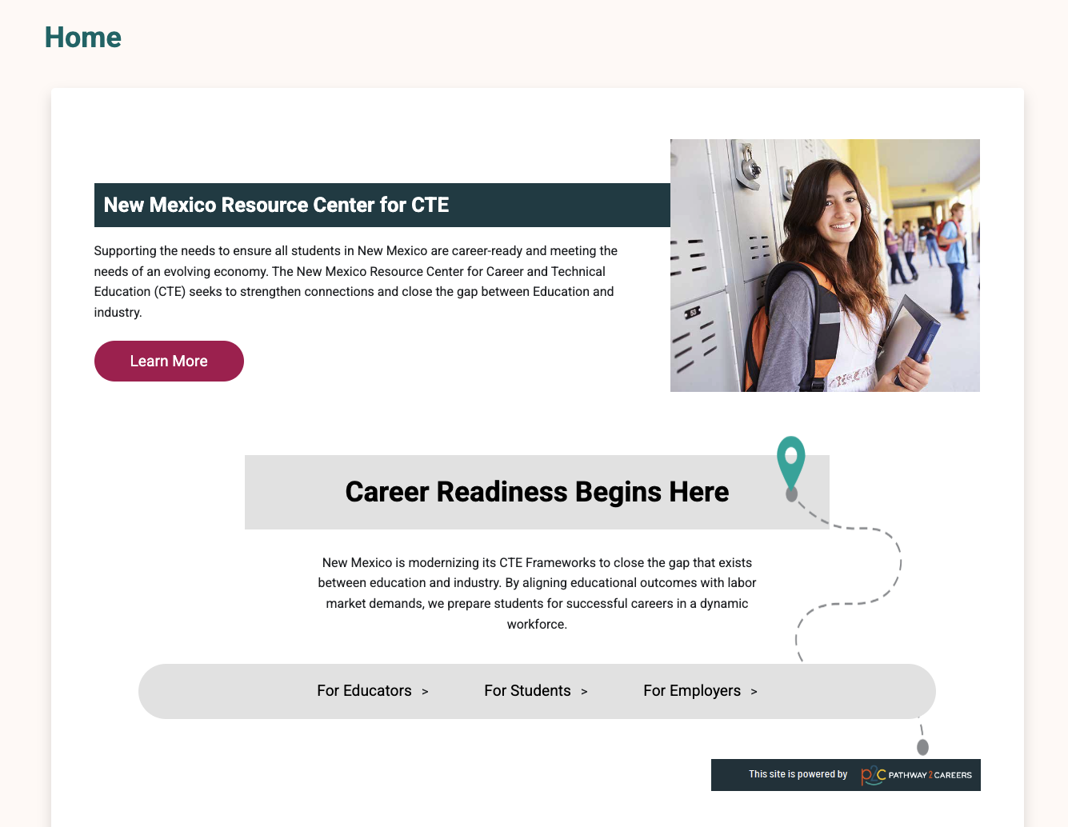

Slide 4
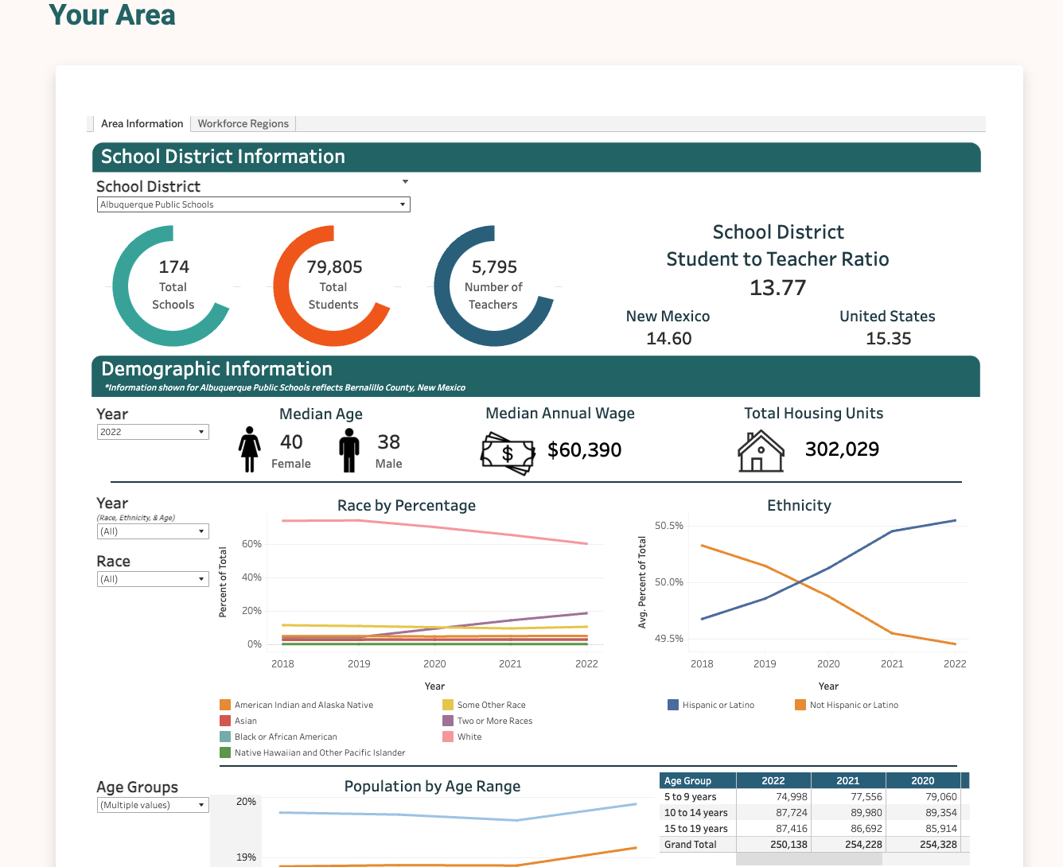

Slide 5
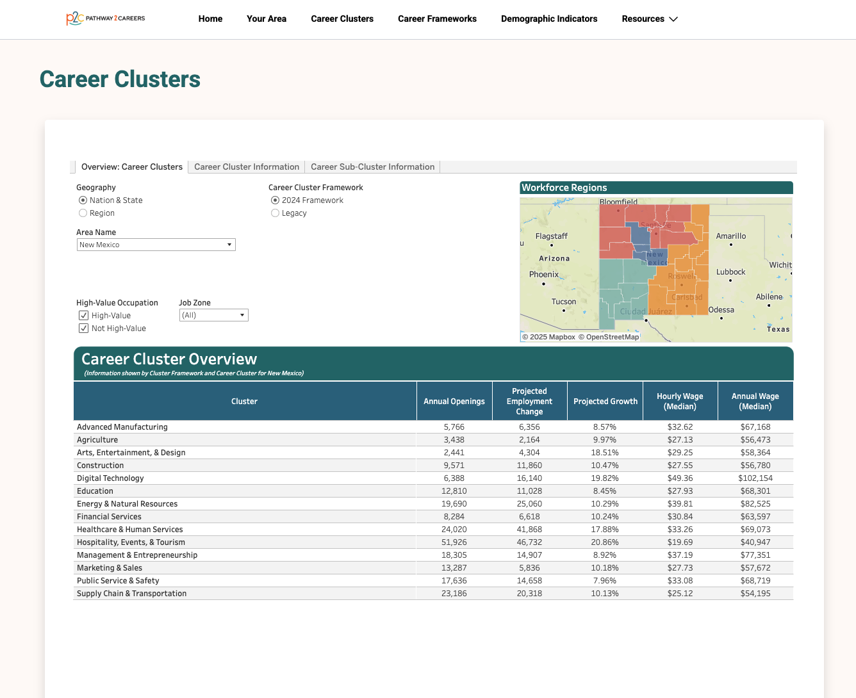

Slide 6
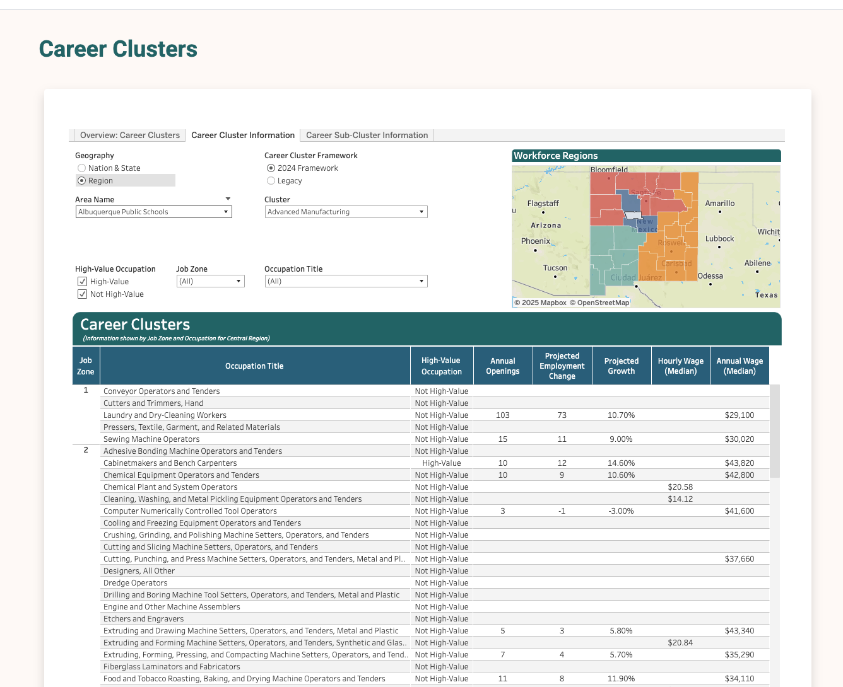

Slide 7
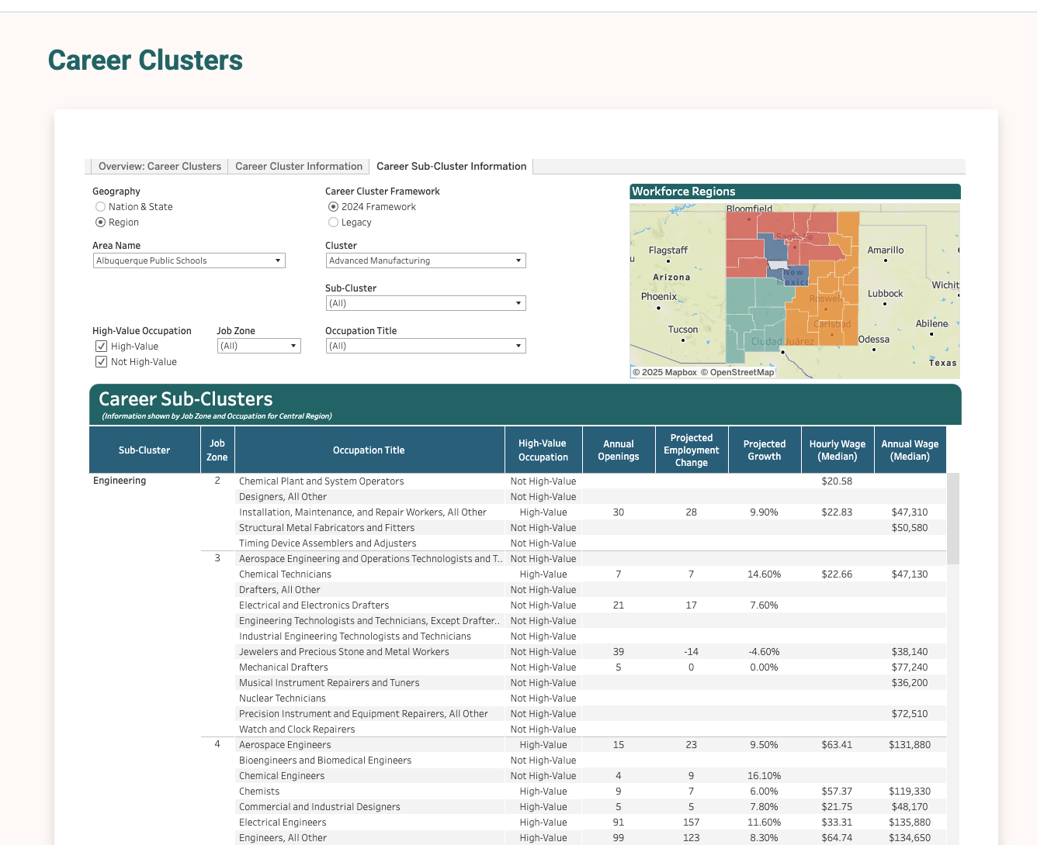

Slide 8
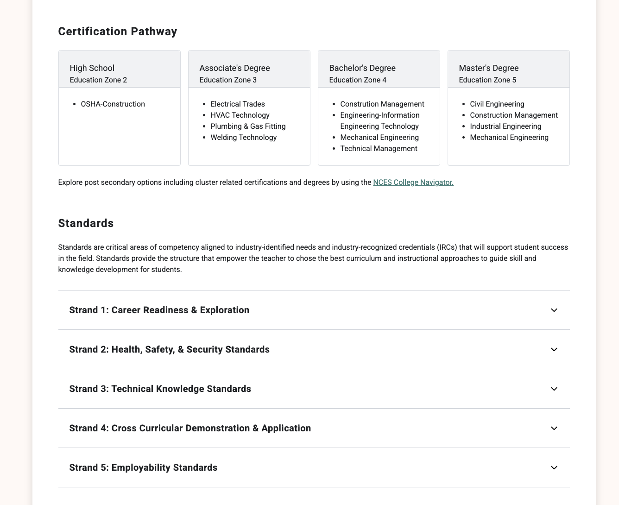
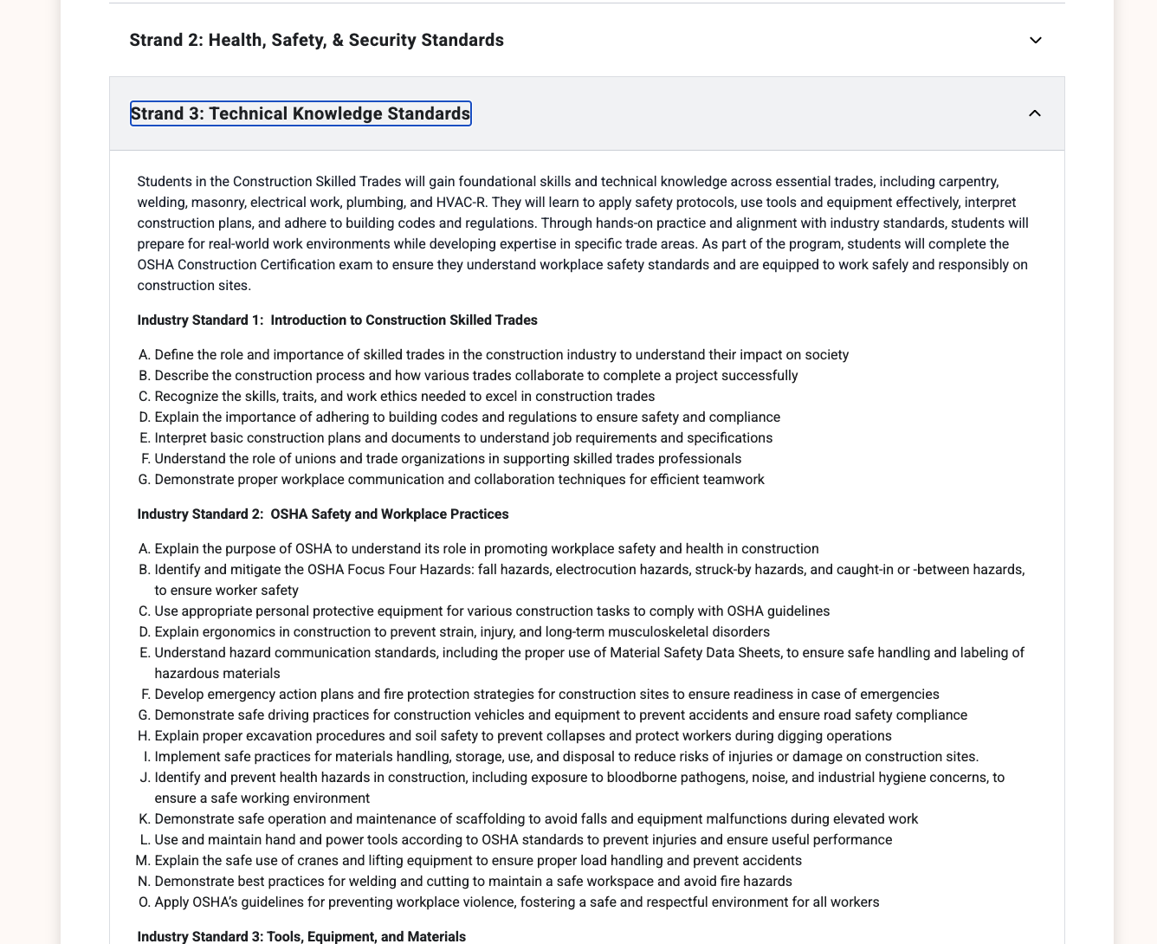
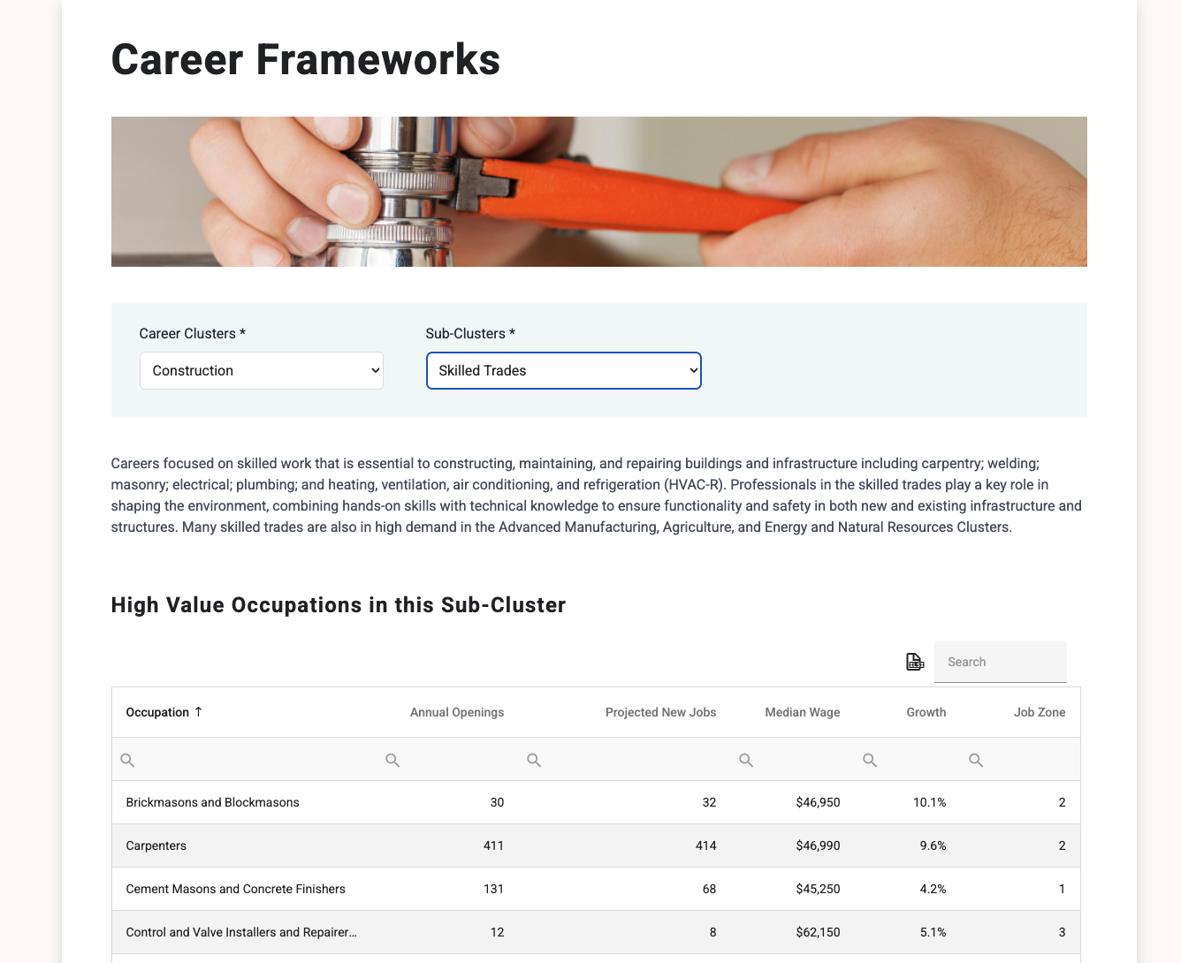

Slide 9
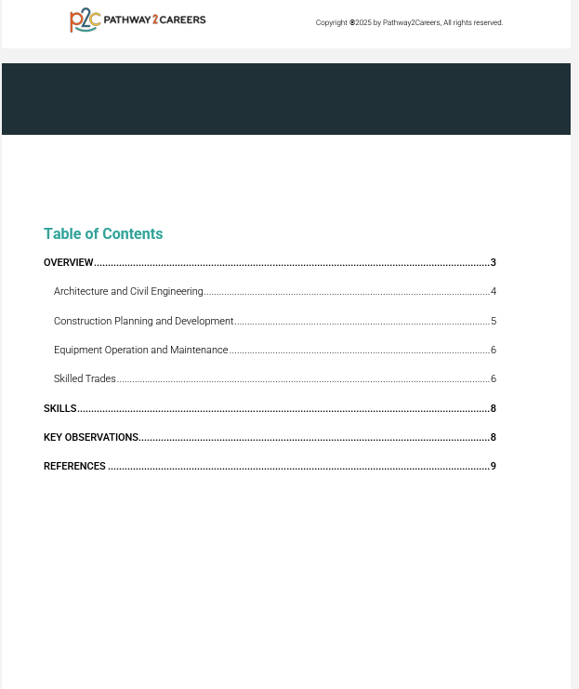

Slide 11
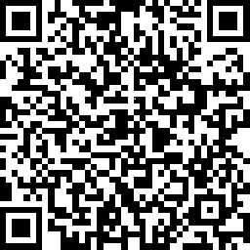
NM CTE Hub Feedback Form
https://www.surveymonkey.com/r/B9LGRW7

