Slide 1
Graduation Requirements HB171
February 12, 2025
Judy Cruz, Education Administrator
College and Career Readiness Bureau (CCRB)
Investing for tomorrow, delivering today.

Slide 2
Introduction
During the 2024 legislative session, Governor Michelle Lujan Grisham signed House Bill 171, School Graduation Requirements, updating high school graduation requirements for the first time in over a decade, with changes becoming effective for students entering ninth grade in the 2025-2026 school year.
The new requirements include the successful completion of a minimum of 24 units aligned to the state academic content and performance standards.

Slide 3
Key Changes
CTE and WBL
Department-approved work-based learning, and career technical in the core content areas of English, mathematics, and science.
Removal of Requirements
Removal of Algebra 2 as a requirement, although it must still be offered as a mathematics course.
Removal of the required Advanced Placement®, honors, dual credit or distance learning units, although a student’s opportunity to take these courses shall not be affected.
Credits Prior to High School
Units prior to enrolling in high school that shall satisfy unit requirements to earn a New Mexico diploma of excellence include:
Health, Algebra 1, and Geometry

Slide 4
Key Changes
Student Choice
Electives shall include a two-unit pathway of concentration of the student’s choice in a language other than English, including American Sign Language (ASL); fine arts; health; military career preparation; career technical education, community or service learning, capstone courses, work-based learning courses;
Provided that financial literacy and computer science shall be offered as electives.
LEA Choice
Two units set by each local school board or governing body that meet department academic content and performance standards.
Demonstration of Competency
Removal of the state required demonstrations of competency in five core subject areas (i.e., mathematics, reading and language arts, writing, social studies, and science). Although high school students must still participate in the state's required Every Student Succeeds Act (ESSA) assessments, the additional requirement of demonstrating competency in five core subject areas is no longer necessary.

Slide 5
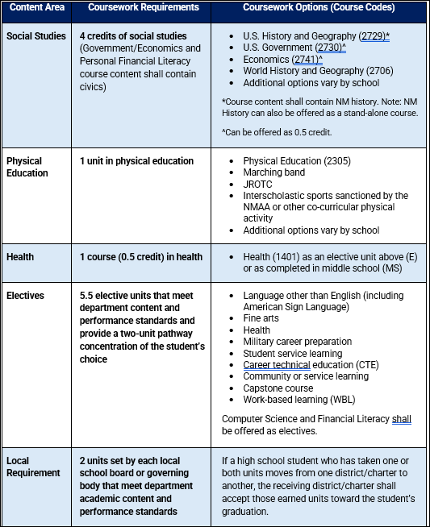
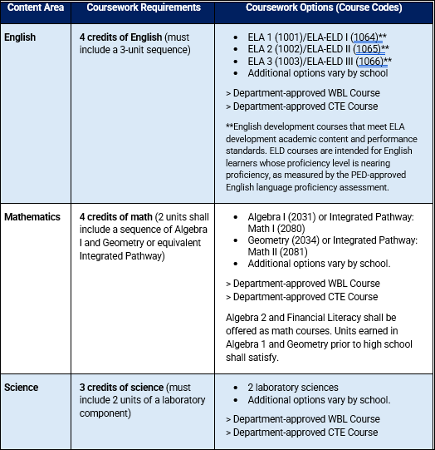
Coursework Requirements

Slide 6
Elective Requirements
5.5 Electives -Including a two-unit pathway concentration of the student’s choice.
Language other than English (including American Sign Language)
Fine arts
Health
Military career preparation
Student service learning
Career technical education (CTE)
Community or service learning
Capstone course
Work-based learning (WBL)

Slide 7
CORE CREDIT FOR:
CAREER TECHNICAL EDUCATION (CTE) AND WORK-BASED LEARNING (WBL) COURSES
The CTE/WBL courses for core credit equivalency process outlined below must align with New Mexico’s Core Content Standards to be eligible for core credit. New Mexico’s Core Content Standards can be viewed on the PED website: NM Core Content Standards – New Mexico Public Education Department

Slide 8
CORE CREDIT FOR:
CAREER TECHNICAL EDUCATION (CTE) AND WORK-BASED LEARNING (WBL) COURSES
General Requirements
Students must earn credit in the following courses with a passing grade of C or better:
English: English 1, English 2, and English 3
Math: Algebra 1 and Geometry or Integrated Math 1 and Integrated Math 2
Science: Two lab sciences
The CTE/WBL teacher of record must hold the proper licenses in the core content areas.

Slide 9
Examples of Integration into Core Subjects
Mathematics Credits: A student engaged in an accounting internship could apply their mathematical skills in real-world contexts, potentially earning math credits if the experience aligns with the academic standards for Algebra 1 and Geometry.
Science Credits: Environmental science students working on conservation projects could earn science credits by applying biological and ecological concepts in fieldwork.
English Credits: Students working in communications or media roles where they create and edit written content could earn English credits if their tasks align with NM Core Content Standards.

Slide 10
CORE CREDIT FOR:
WORK-BASED LEARNING (WBL) COURSES
3 Paths
Course Content Standards Crosswalk
Mastery Scores
CTE WBL Capstone Completer Course

Slide 11
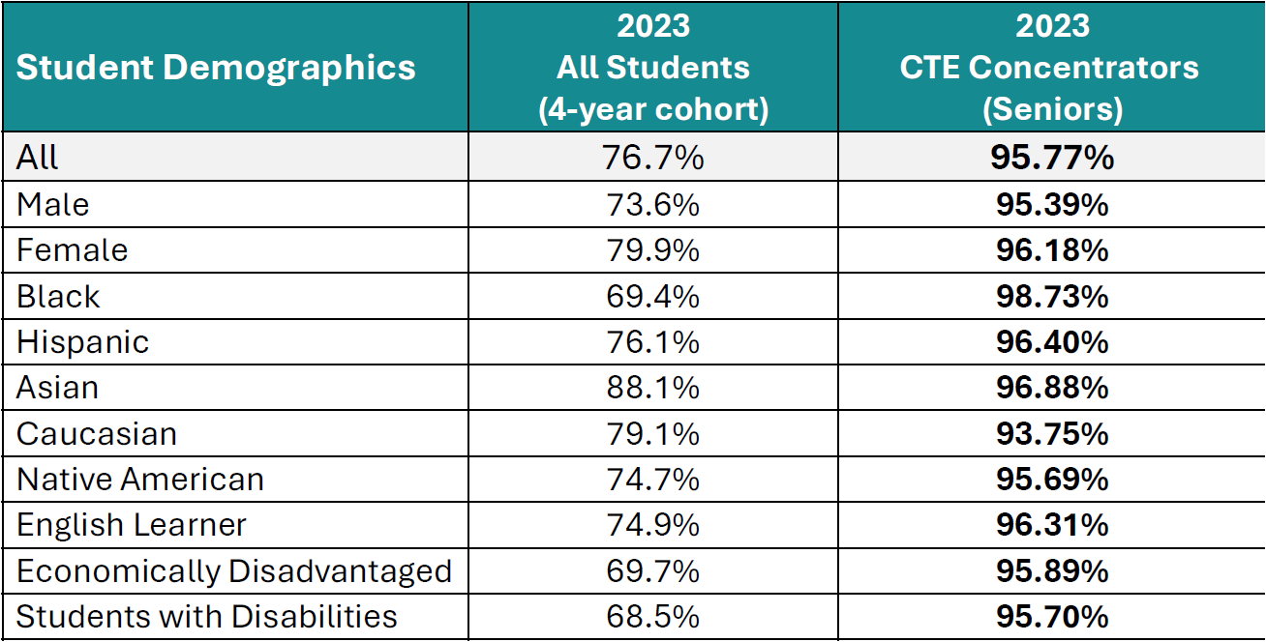
CTE Concentrator Graduation Rates

Slide 12
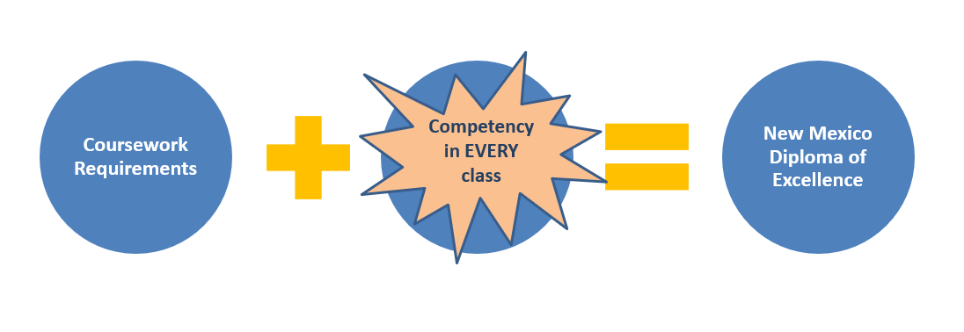
Add a Slide Title - 4
Shifting the Perspective of Competency
THEN
NOW
(HB171)
6.29.1 NMAC, General Provisions
Final examination. A final examination shall be administered to all students in all courses offered for credit.

Slide 13
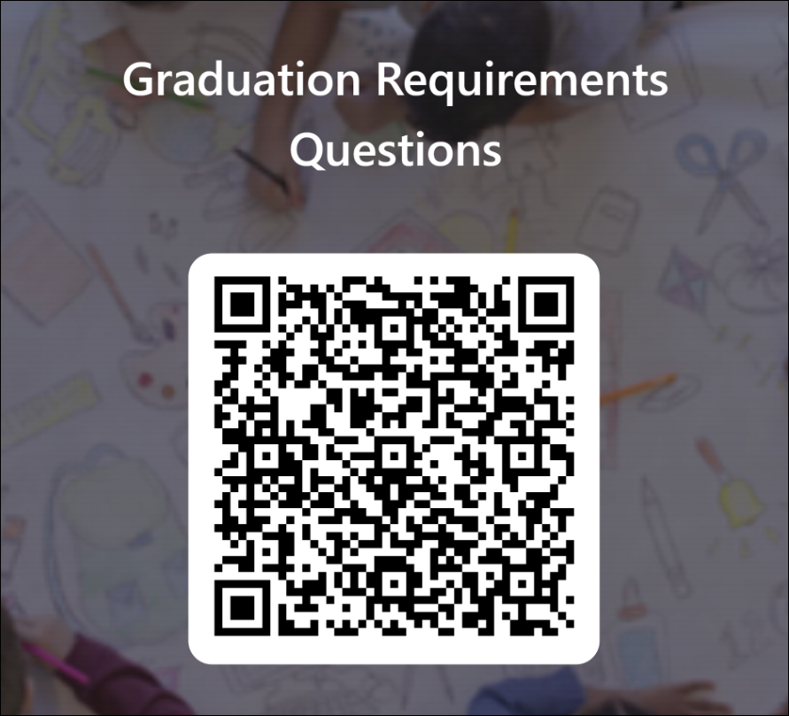
Quick Response Code

Slide 14
Questions?
Email:
PED.Assessment@ped.nm.gov for assessment related questions.
Grad.Questions@ped.nm.gov for graduation coursework questions.
OSE.Support@ped.nm.gov for special education programs of study questions.

